Slide 1


Slide 2
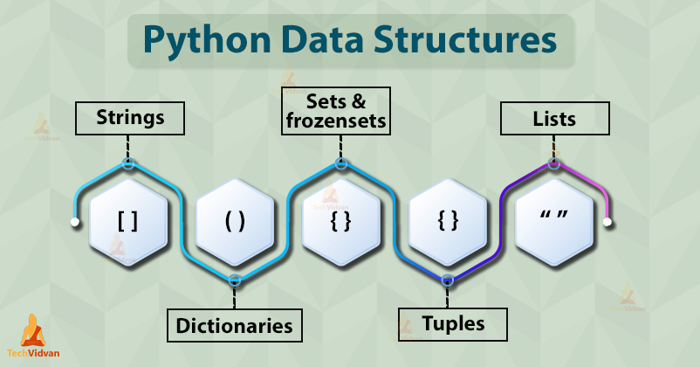
Python Data Types

Slide 3
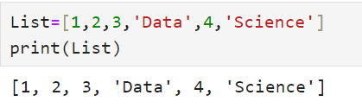
List in python
Python’s list is a flexible, versatile, powerful, and popular built-in data type.
It allows you to create variable-length and mutable sequences of objects.
In a list, you can store objects of any type.
You can also mix objects of different types within the same list, although list elements often share the same type.
Commonly called containers or collections because a single list can contain or collect an arbitrary number of other objects.

Slide 4
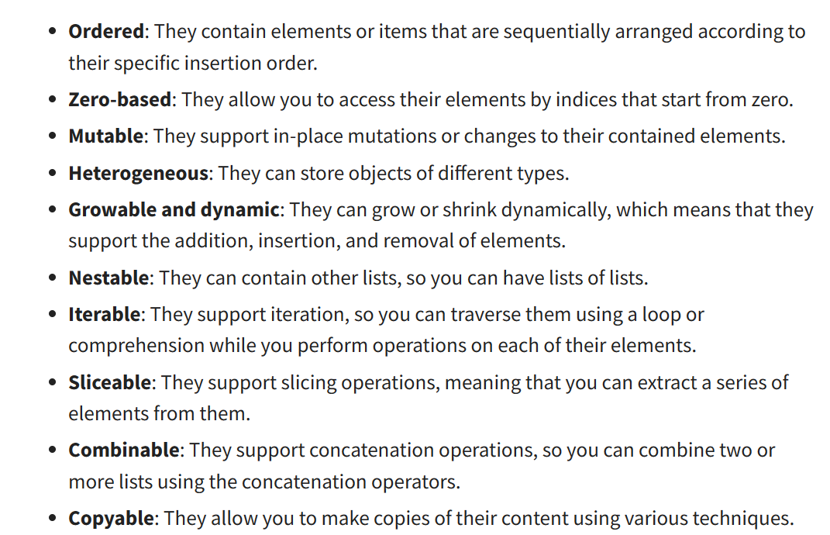
Characteristics of List Objects

Slide 5
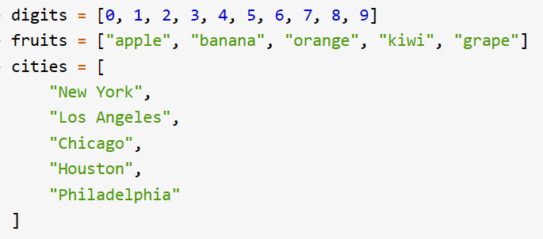
Constructing Lists in Python
List in python can be created using 3 methods:
1. List Literals

Slide 6
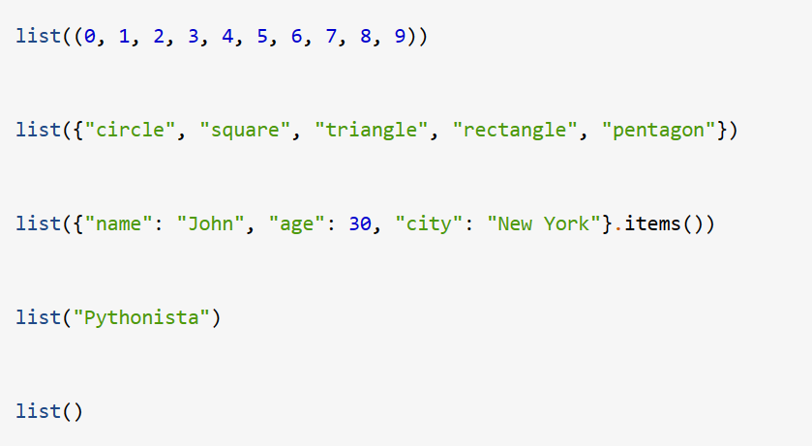
Constructing Lists in Python
List in python can be created using 3 methods:
2. list()

Slide 7
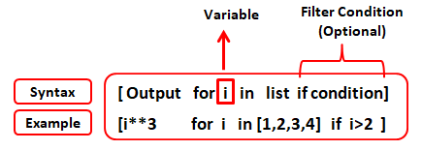
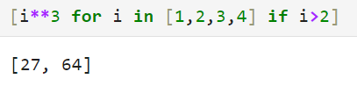
Constructing Lists in Python
List in python can be created using 3 methods:
3. list Comprehension
List comprehensions allow you to quickly create and transform lists using a syntax that mimics a for loop but in a single line of code.

Slide 8
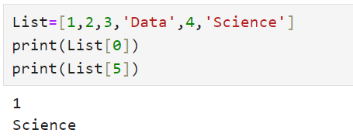
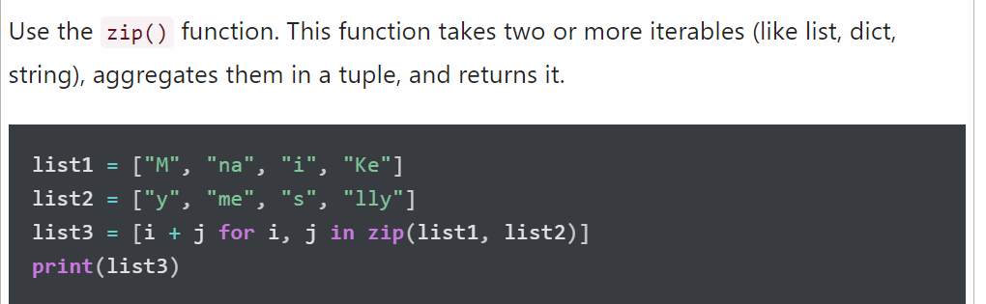
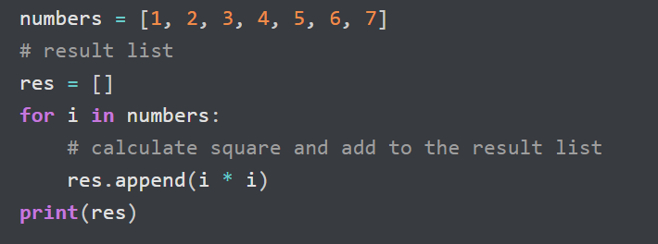
Accessing values from the list

Slide 9
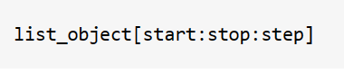
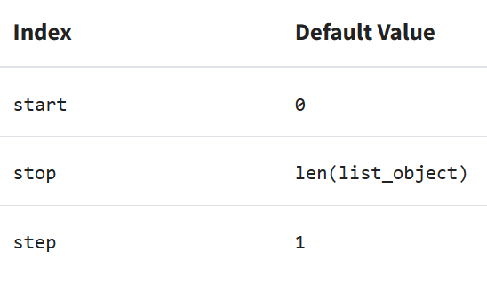
Accessing Multiple Items from the List
The [start:stop:step] part of this construct is known as the slicing operator.
Its syntax consists of a pair of square brackets and three optional indices, start, stop, and step.
The second colon is optional. You typically use it only in those cases where you need a step value different from 1.

Slide 10
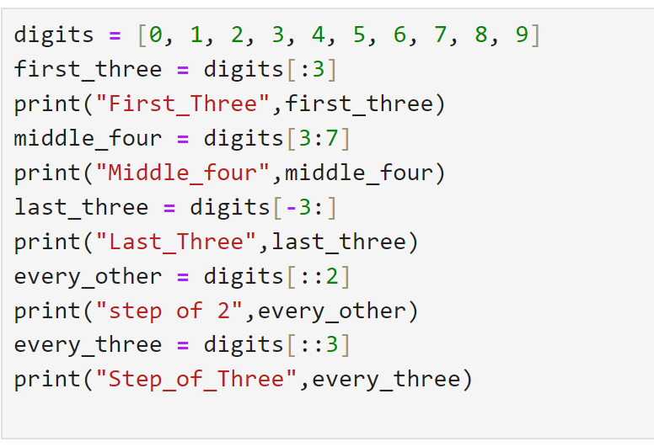
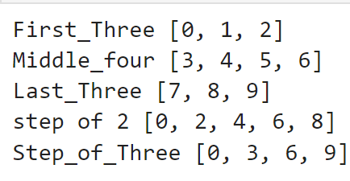
Slicing List

Slide 11
Creating a copy of a List
In Python, you’ll have two kinds of mechanisms to create copies of an existing list. You can create either:
A shallow copy
A deep copy
A shallow copy of an existing list is a new list containing references to the objects stored in the original list. In other words, when you create a shallow copy of a list, Python constructs a new list with a new identity. Then, it inserts references to the objects in the original list into the new list.
In a deep copy of a list, Python constructs a new list object and then inserts copies of the objects from the original list recursively.

Slide 12
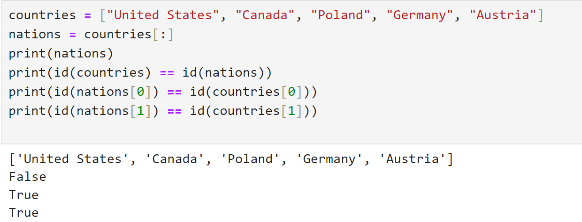
Shallow Copy (Three Methods)
The Slicing Operator
.copy() method
Copy() function of copy module
Note: As we change the values in the List the id changes

Slide 13
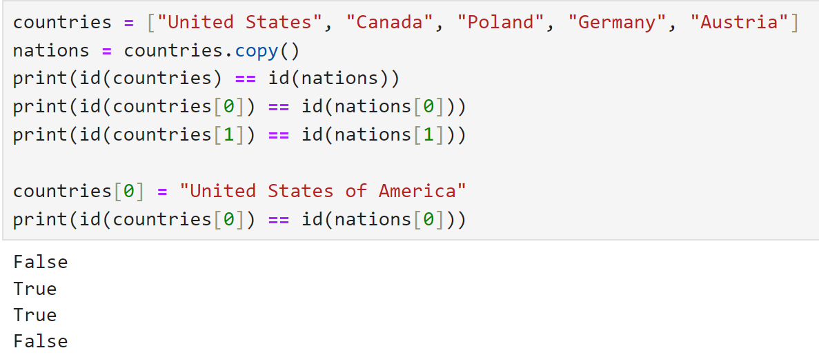
Shallow Copy (Three Methods)
The Slicing Operator
.copy() method
Copy() function of copy module

Slide 14
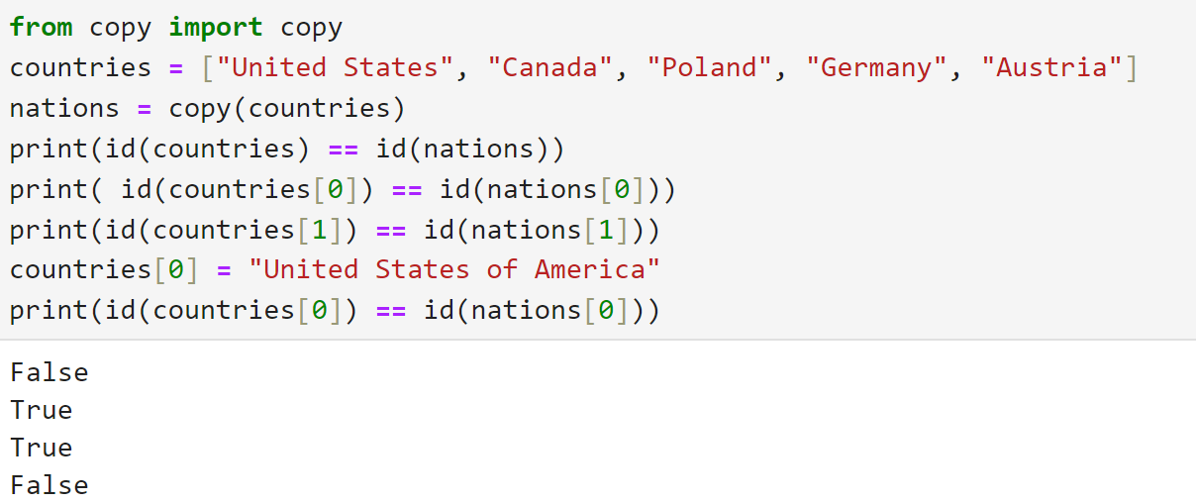
Shallow Copy (Three Methods)
The Slicing Operator
.copy() method
Copy() function of copy module

Slide 15
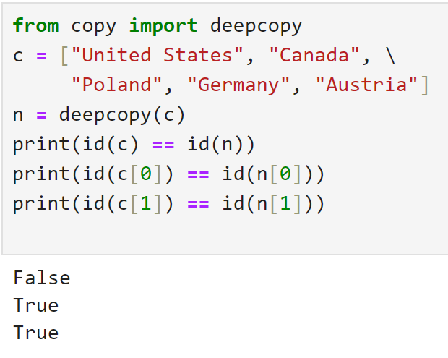
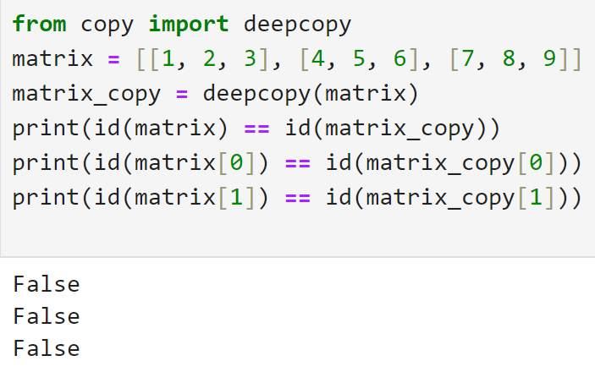
Deep Copy of List
In case of immutable Objects deepcopy behaves same as shallow copy

Slide 16
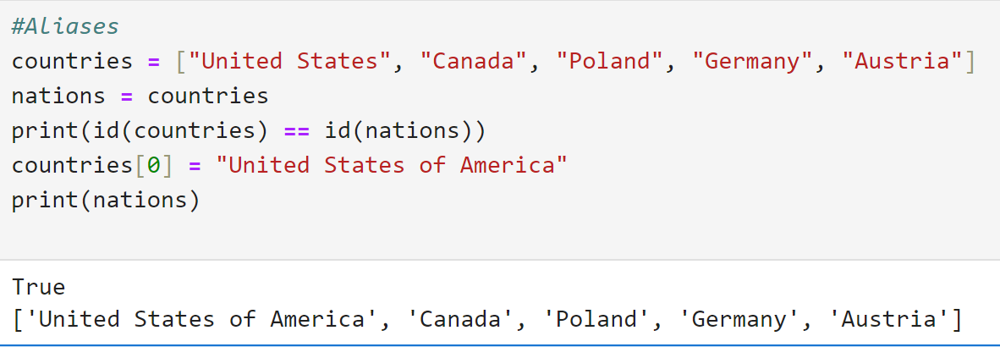
Copy vs Aliases of List

Slide 17
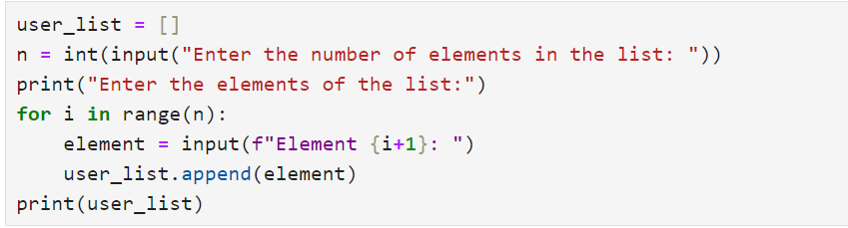
Reading List from User

Slide 18
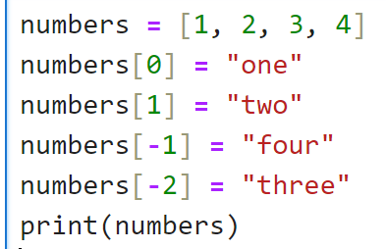
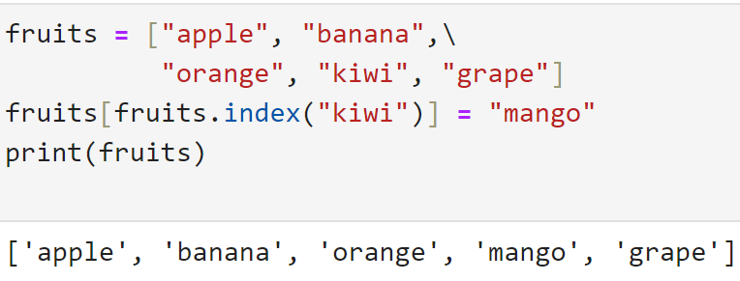
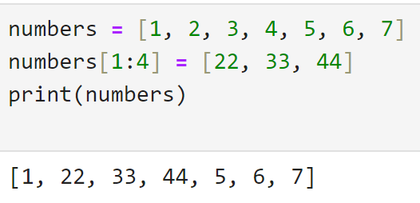
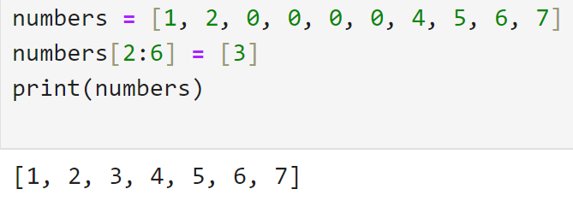
Updating items in List
2
1
3
4

Slide 19
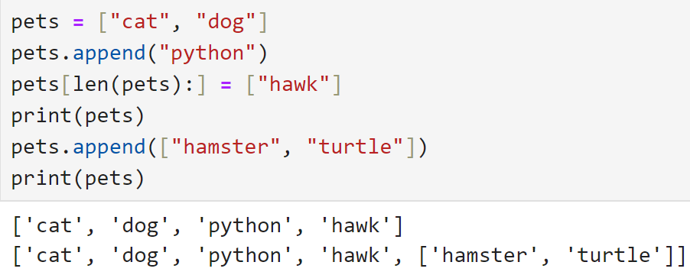
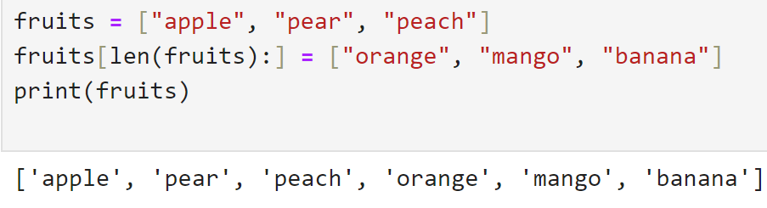
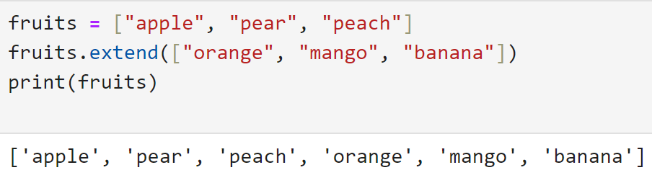
Growing and Shrinking List Dynamically
1
3
2

Slide 20
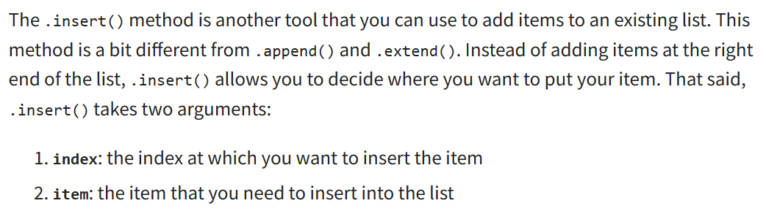
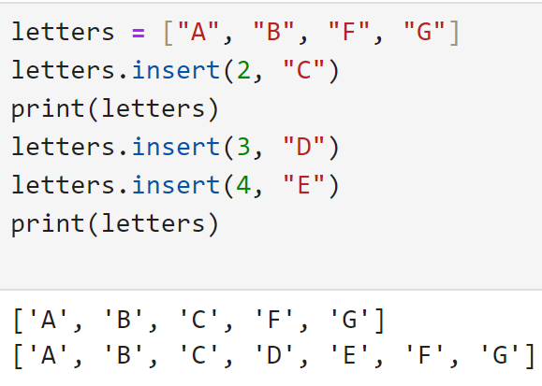
Inserting elements in List

Slide 21
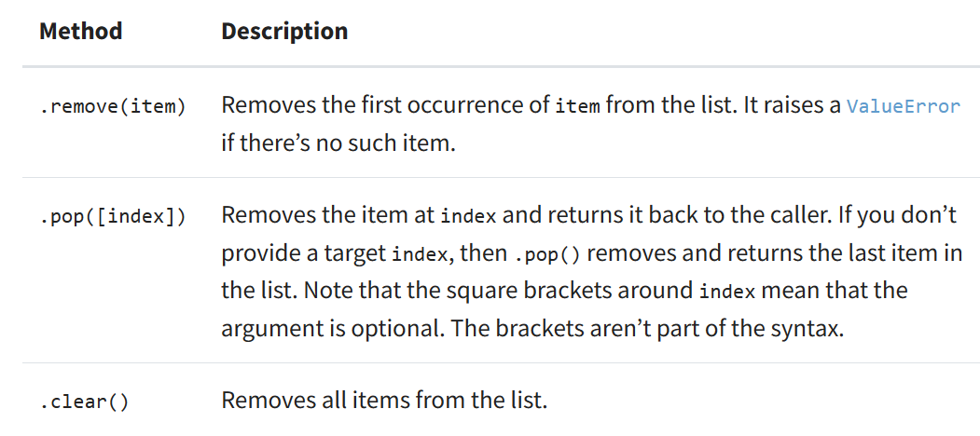
Delete Items from the List

Slide 22
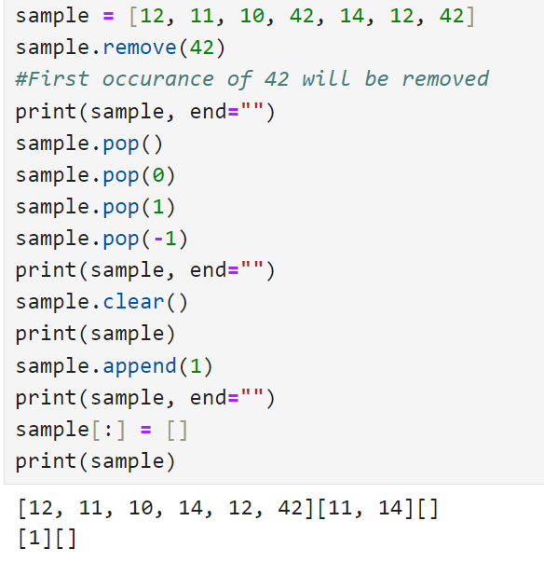
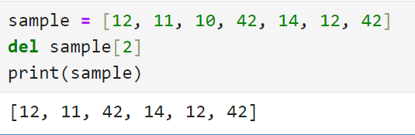
Delete Items from the List
Using del Keyword

Slide 23
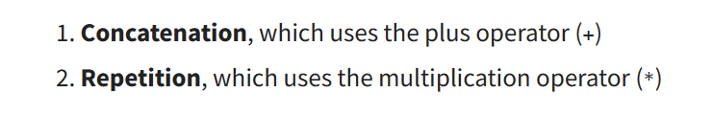
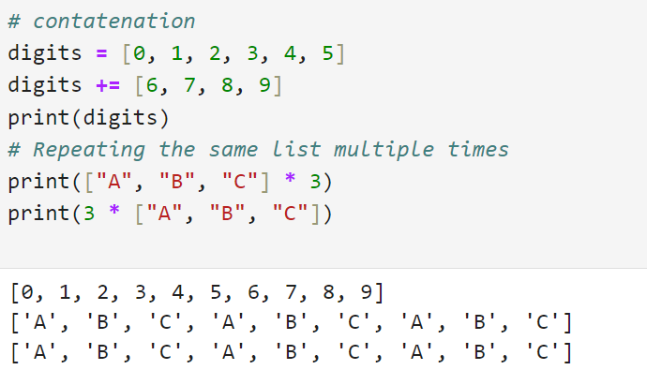
Concatenating and Repeating Lists

Slide 24
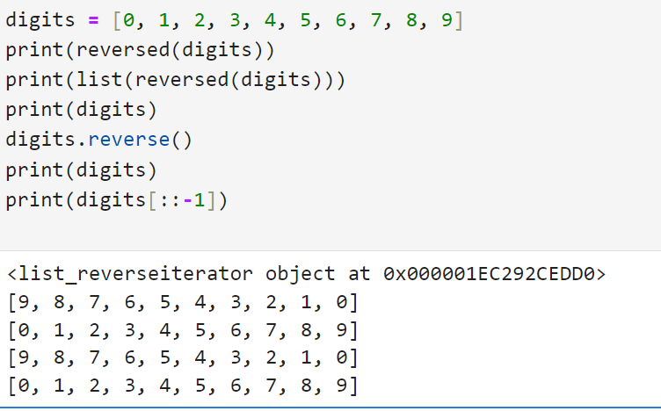
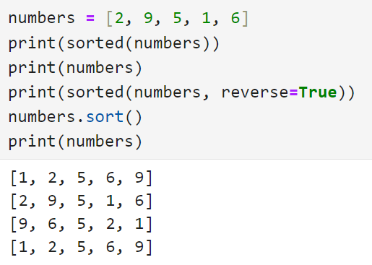
Reversing a List Sorting a List

Slide 25
Assignment-3
Write a Python program to count the number of strings from a given list of strings. The string length is 2 or more and the first and last characters are the same. Sample List : ['abc', 'xyz', 'aba', '1221'] Expected Result : 2
Write a Python program to remove duplicates from a list.
Write a Python program to check if a list is empty or not.
Write a Python program to find the list of words that are longer than n from a given list of words.
Write a Python program to print a specified list after removing the 0th, 4th and 5th elements. Sample List : ['Red', 'Green', 'White', 'Black', 'Pink', 'Yellow'] Expected Output : ['Green', 'White', 'Black']

Slide 26
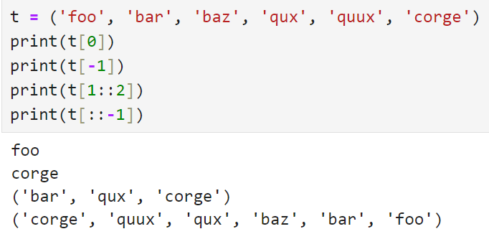
Tuple in Python
Python provides another type that is an ordered collection of objects, called a tuple.
Tuples are immutable and can store a fixed number of items.
For example, you can use tuples to represent Cartesian coordinates (x, y), RGB colors (red, green, blue), records in a database table (name, age, job), and many other sequences of values.
In all these use cases, the number of elements in the underlying tuple is fixed, and the items are unchangeable.

Slide 27
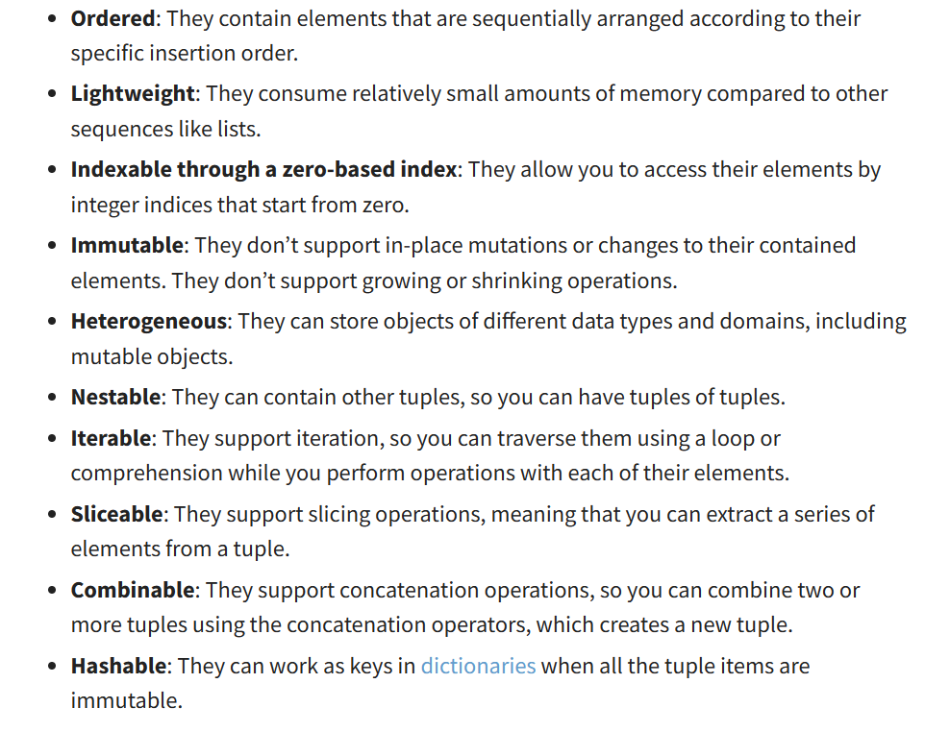
Characteristics of Tuple

Slide 28
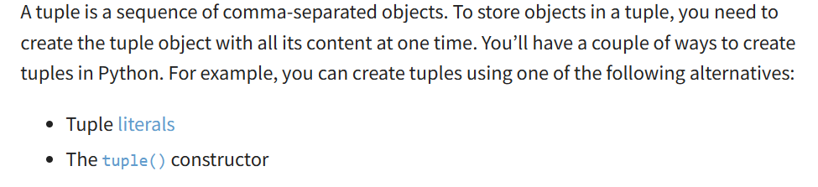
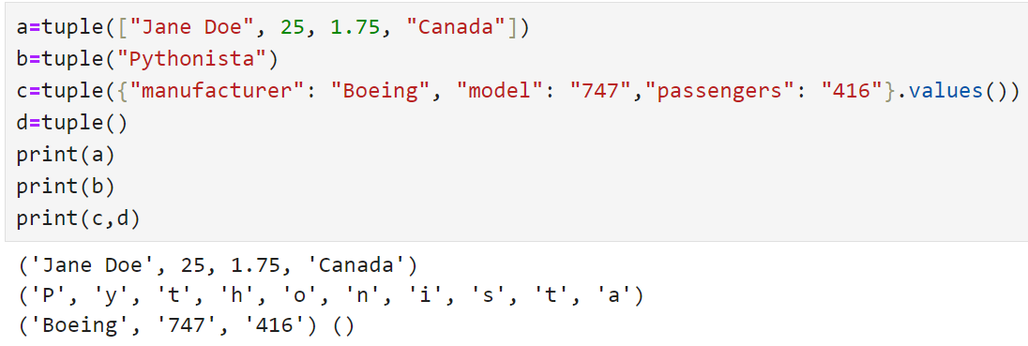
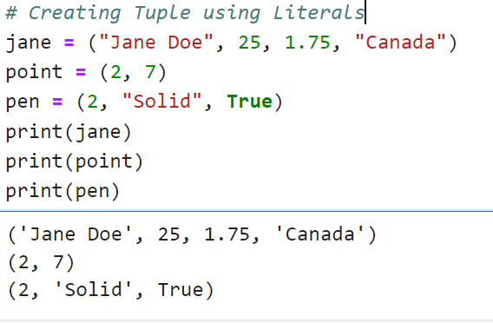
Constructing Tuple in Python
1
2

Slide 29
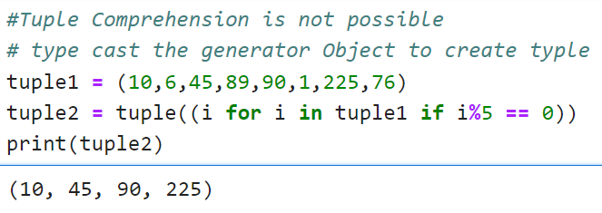
Tuple as a result of Wrapping the generator Object

Slide 30
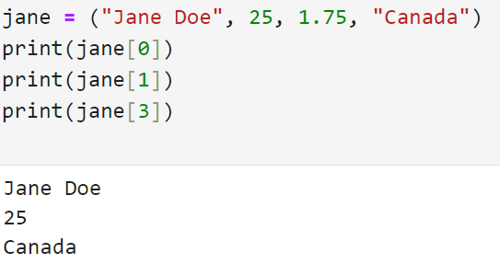
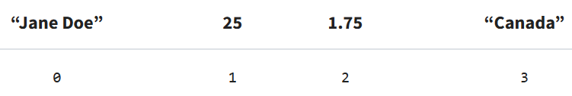
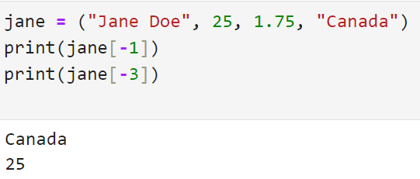
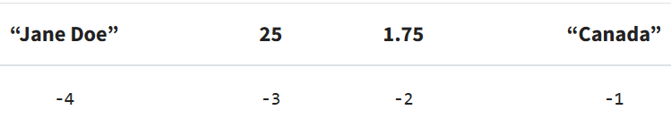
Accessing Items in a Tuple: Indexing

Slide 31
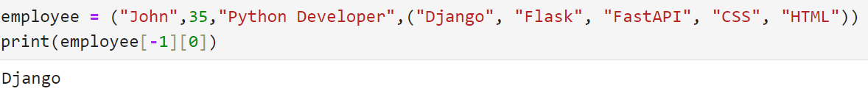
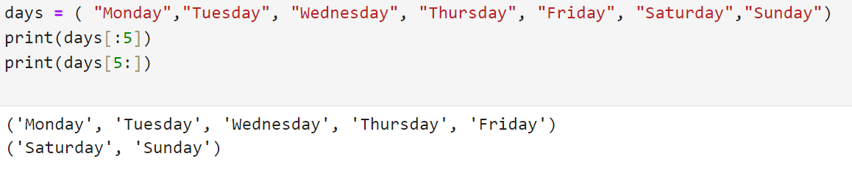
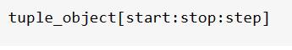
Accessing Items in a Tuple: Indexing
Retrieving Multiple Items From a Tuple: Slicing

Slide 32


Exploring Tuple Immutability

Slide 33



Exploring Tuple Immutability

Slide 34



Packing and Unpacking Tuples
1
2

Slide 35


Packing and Unpacking Tuples

Slide 36

Creating Copies of a Tuple

Slide 37


Copy() function of copy module
The Slicing Operator
Shallow Copy Example

Slide 38


Deep Copy Example

Slide 39


Concatenating and Repeating Tuples
Augmented Variation
Repeating Tuples

Slide 40


Reversing and Sorting Tuples
Reversing using reversed() and slicing operator
Sorting a tuple returns list

Slide 41


Traversing Tuples in Python
1
2

Slide 42


Finding Items in a Tuple Assignment-4

Slide 43



Sets and Frozen Sets in Python
A set is a collection of unique data, meaning that elements within a set cannot be duplicated.
For instance, if we need to store information about student IDs, a set is suitable since student IDs cannot have duplicates.
Characteristics

Slide 44



Create a Set in Python
In Python, we create sets by placing all the elements inside curly braces {}, separated by commas.
A set can have any number of items and they may be of different types (integer, float, tuple, string, etc.).
But a set cannot have mutable elements like lists, sets or dictionaries as its elements.

Slide 45

Create an Empty Set in Python
Creating an empty set is a bit tricky. Empty curly braces {} will make an empty dictionary in Python.
To make a set without any elements, we use the set() function without any argument. For example,

Slide 46


Duplicate Items in a Set
Add and Update Set Items in Python

Slide 47


Remove an Element from a Set
discard() method
Enumerate Function

Slide 48


Slide 49

Set Comprehension

Slide 50

Iterate over a set

Slide 51


Python Set Operations(Union)

Slide 52


Python Set Operations(Intersection)

Slide 53


Python Set Operations(Difference)

Slide 54


Python Set Operations(Symmetric Difference)

Slide 55

Dictionary in Python
A Python dictionary is a collection of items, similar to lists and tuples. However, unlike lists and tuples, each item in a dictionary is a key-value pair (consisting of a key and a value).

Slide 56



Creating a Dictionary (using {})

Slide 57


Creating a Dictionary (using dict())
Accessing Dictionary Items

Slide 58


Add Items to a Dictionary
Delete an item from Dictionary

Slide 59


Change Dictionary Items

Slide 60

Dictionary Comprehension

Slide 61



Iterate Through a Dictionary
2
1
3

Slide 62

Reading Dictionary from User

Slide 63

Dictionary Functions

Slide 64

Dictionary Membership test

Slide 65
Assignment-5
1) Write a Python script to sort (ascending and descending) a dictionary by value.
2) Write a Python script to concatenate the following dictionaries to create a new one.
Sample Dictionary : dic1={1:10, 2:20} dic2={3:30, 4:40} dic3={5:50,6:60} Expected Result : {1: 10, 2: 20, 3: 30, 4: 40, 5: 50, 6: 60}
3) Write a Python script to print a dictionary where the keys are numbers between 1 and 15 (both included) and the values are the square of the keys.
4) Write a Python program to remove duplicates from the dictionary.
5) Write a Python program to print all distinct values in a dictionary. Sample Data : [{"V":"S001"}, {"V": "S002"}, {"VI": "S001"}, {"VI": "S005"}, {"VII":"S005"}, {"V":"S009"},{"VIII":"S007"}] Expected Output : Unique Values: {'S005', 'S002', 'S007', 'S001', 'S009'}

Slide 66




Contact Us
FLY THE NEST
Connekt,
13TH Floor, Gala Empire, Thaltej,
Ahmedabad, Gujarat, India
+91 6354283836
info@flythenest.in
www.flythenest.in

Slide 67
Thank You

